Slide 1

StreamFlix Global Viewer Insights
Alexander Brown Anisha Issac Laura Vuong Sreelakshmi Sudey

Slide 2
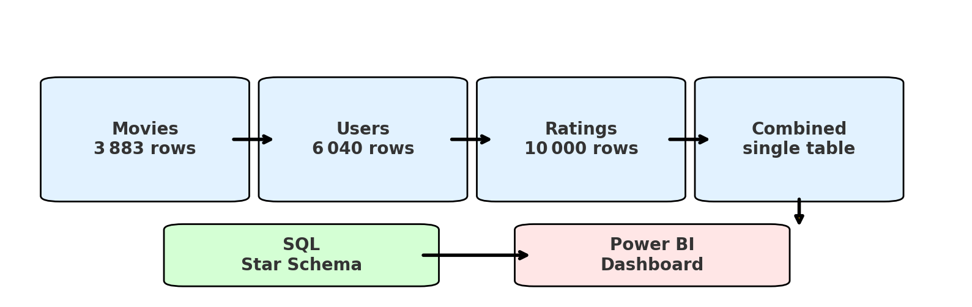
Project Overview
StreamFlix Data Pipeline – 4 Sources → 1 Dashboard

Slide 3
Objectives We Answered
1. Highest-rated movies 2. Most-popular genres 3. Age-group viewing 4. Subscription split 5. Viewer country footprint 6. Device mix Two “bonus” insights: – Genre demand gap – User- Gender- imbalance

Slide 4

Top 10 Movies

Slide 5
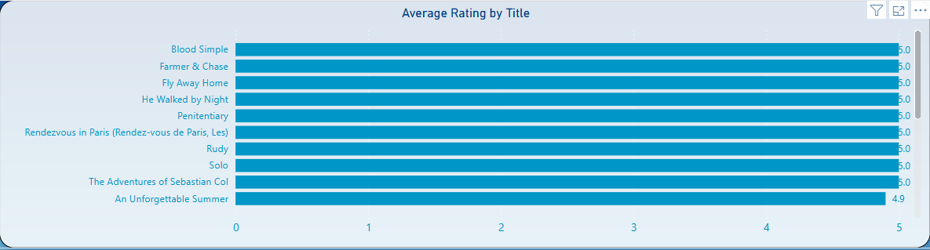

Slide 6

Most Popular Genres

Slide 7
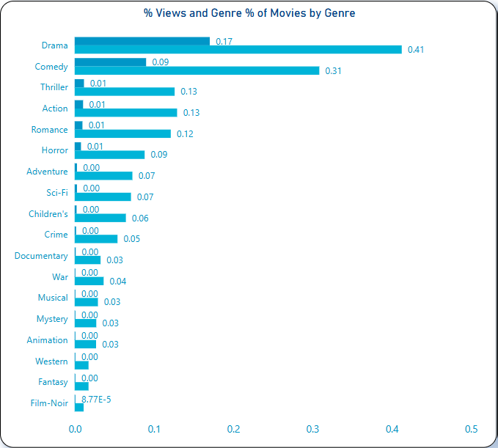
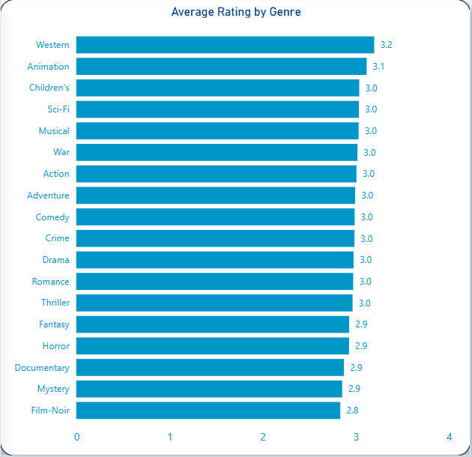

Slide 8
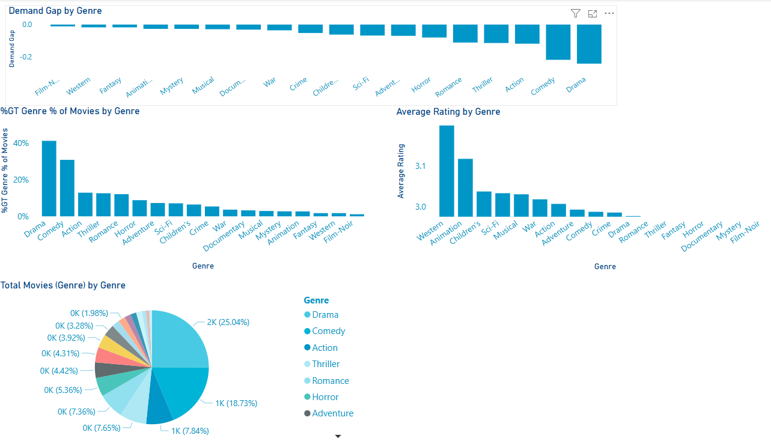

Slide 9
Free vs. Subscribed Users
Subscription Status Analysis

Slide 10
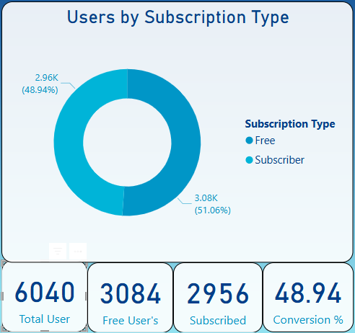
A nearly even split:- opportunity to convert Free users with targeted upsell campaigns.

Slide 11
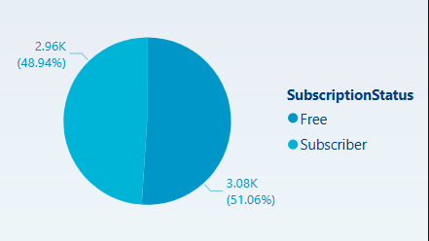
Watch time is almost identical across both groups. Content is engaging even in the free tier.

Slide 12
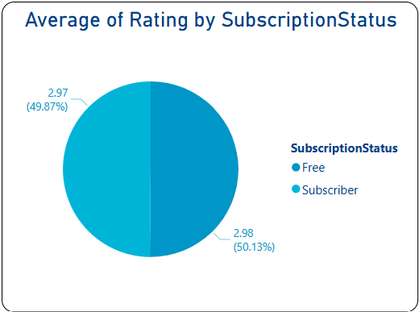
Users rate closely regardless of subscription. Focus on maintaining quality over pricing.

Slide 13
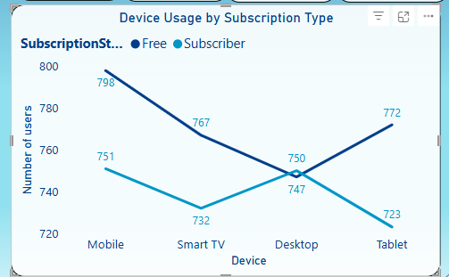
Mobile is the top device among Free users, a smart place to prompt subscription upgrades.
Desktop users most likely to be subscribers, investigating the user interface here may be insightful to help conversion from free to subscription on other platforms.

Slide 14
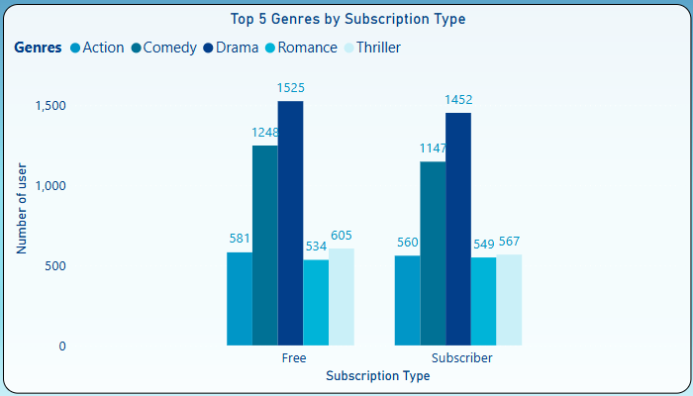
Genre user interaction rates are closely aligned across both subscription types. This may indicate that the catalogue is well supported in these areas.

Slide 15
Recommendations
Focus push notifications on mobile free users with premium previews.
Use Drama & Comedy content to promote subscriptions.
Since watch time and ratings are nearly equal, pricing nudges and exclusive features might convert better than content gating.

Slide 16

Subscription Analysis by Country
Comparing user behaviour and engagement across countries, by Subscription Status.

Slide 17
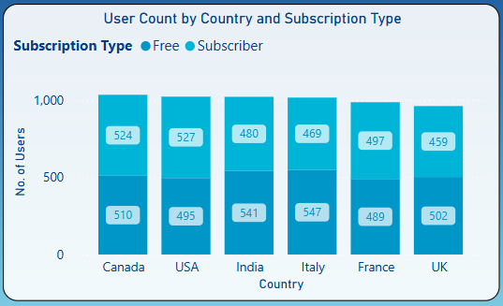
Canada, USA, and India lead in user count. High Free user base in India and Italy signals opportunity for growth.

Slide 18
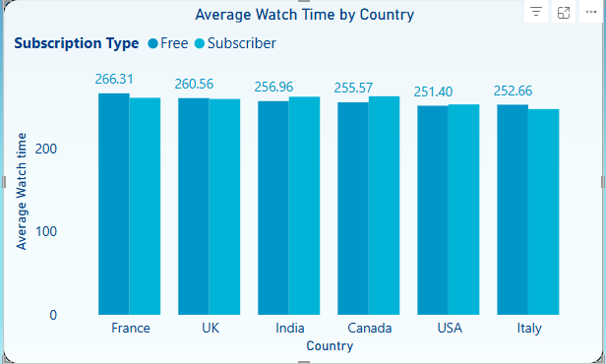
Free users in France show highest watch time. Watch time is fairly consistent across subscription tiers.

Slide 19
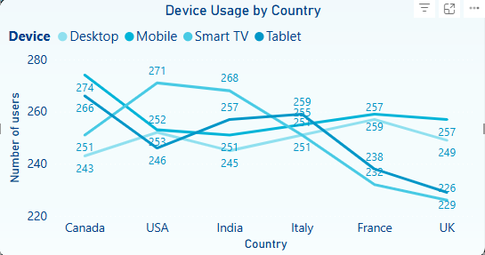
Mobile and tablet dominate across all countries. Tailor subscription prompts to device usage patterns.

Slide 20

Target France for Free-to-Subscriber conversion
Optimise UI for mobile-first countries subscriptions.
Reinforce value in high-subscription regions
Geo-personalised engagement
Key Insights & Recommendations

Slide 21
Currently operating in: Canada, USA, UK, France, Italy, India
Existing data shows strong Free user engagement and watch time
Consistent patterns suggest potential in similar international markets
Opportunity to Scale Movie Streaming Globally

Slide 22
Opportunity to Scale Movie Streaming Globally
Key indicators for global readiness:
High engagement from Free users
Mobile and tablet dominant usage
Diverse viewing preferences across genres
Recommend exploring expansion via:
Pilot programs in new regions
Localised content and language support
Data-driven testing of recommendations and pricing

Slide 23
Age Group & Device

Slide 24
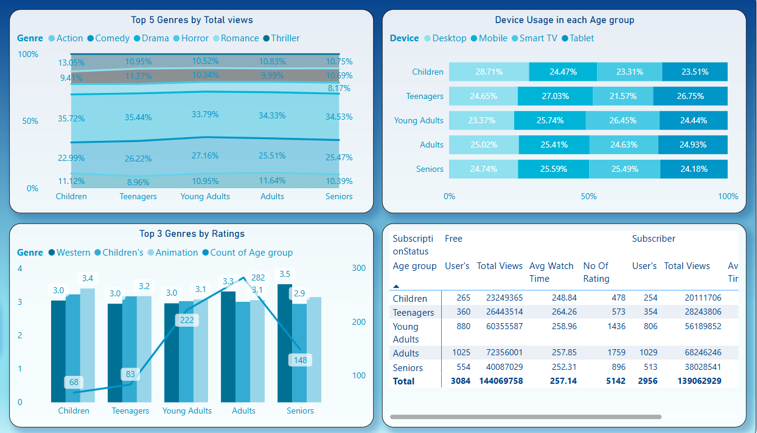
Age Group
Children (<12)

Slide 25
Age Group
Teenagers (13 - 19)

Slide 26
Age Group
Young Adult (20 - 35)

Slide 27
Age Group
Adult (36 - 55)

Slide 28
Age Group
Senior (>55)

Slide 29
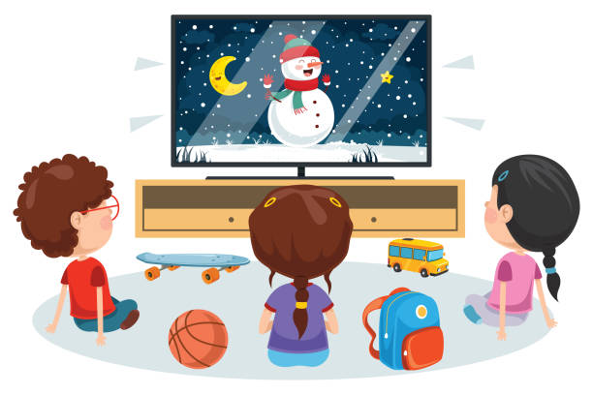




Children
Promote animation content more in the home page and recommendations.
Even though thriller is watched more, animation emotionally resonates better.
Develop a child-friendly desktop interface with parental controls.
Teenagers
Deprioritize action content in their recommendations; focus more on romance and drama.
Optimize mobile/tablet streaming experience (e.g., UI design, quick access).
Recommend binge-worthy series or short-form content formats.
Age Group
Recommendation
Young Adult
Strengthen the library of comedy and drama content.
Consider features that enhance Smart TV user experience like personalized watchlists, shared viewing features, or watch parties.
Highlight trending comedies for this segment.
Adults
They are heavy viewers compared to other age group, so target them by continue investing in drama and action genres.
Target this group with mobile-friendly content and offline viewing options.
Use in-app notifications or personalized suggestions to retain high engagement.
Seniors
Reinforce drama and western genres.
Simplify navigation for mobile and TV users; ensure accessibility (e.g., subtitles, large fonts).
Recommend nostalgic or classic content for emotional engagement.

Slide 30
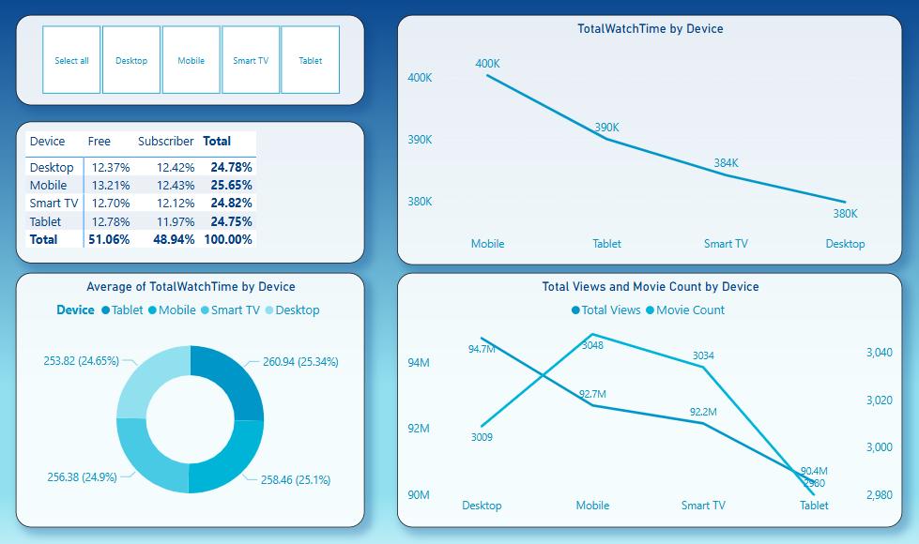
Device - Mobile

Slide 31
Device - Desktop

Slide 32
Device – Smart TV

Slide 33
Device - Tablet

Slide 34


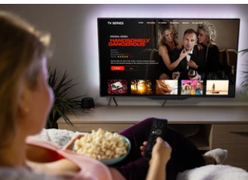
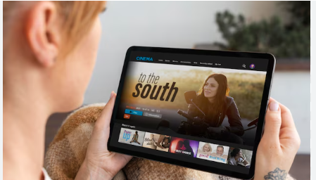

Convert Mobile Viewers with Targeted Offers
Launch mobile-first upgrade campaigns for free users.
Use in-app prompts after binge sessions to suggest Premium.
Highlight mobile perks like offline downloads, ad-free streaming, and early access.
Leverage Desktop Usage for Premium Features
Promote multi-device streaming and premium video quality.
Offer feature comparisons between free vs. paid plans during desktop sessions.
Trigger upgrade prompts after users hit high view thresholds.
Device
Recommendation
Enhance Smart TV Experience for Family Plans
Encourage paid plans with multi-profile access, parental controls, and exclusive content.
Highlight Smart TV benefits during evening/weekend viewing hours.
Boost Tablet Engagement Among Subscribers
Promote long-form or immersive content on tablets (e.g., series, documentaries).
Offer tablet-specific trials o rewards for consistent tablet viewers.
Improve UX and app performance if needed.
Use Personalized Messaging Across Devices
Show upgrade prompts like: “You’ve watched 5+ movies this week – unlock unlimited access!” “Your screen is perfect for Premium HD – Try it now.”

Slide 35
Bonus Insights

Slide 36
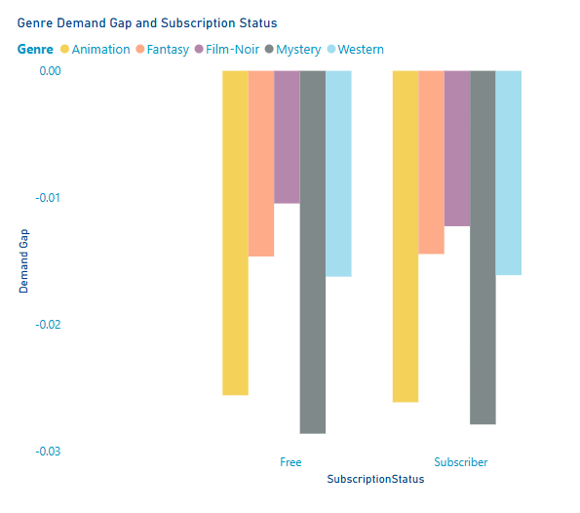
Demand Gap
Demand Gap = % Views − % Catalogue (negative = oversupplied).
Even though every genre is technically oversupplied, the least-negative gaps represent the best relative demand.
Top 5 “in-demand” genres (lowest negative gap)
Film-Noir (−1.0 pp) • only 1 % of catalogue, almost equal share of views
Western (−1.7 pp) • 1.7 % of titles, holds its own in views
Fantasy (−1.7 pp) • niche catalogue, steady engagement
Animation (−2.6 pp) • 2.7 % of titles, retains family-loyal audience
Mystery (−2.7 pp) • 2.5 % of titles, near-parity viewing share
Action‐able insight: These five genres outperform the rest of the catalogue on a per-title basis—prime targets for incremental licensing or marketing spotlights.

Slide 37
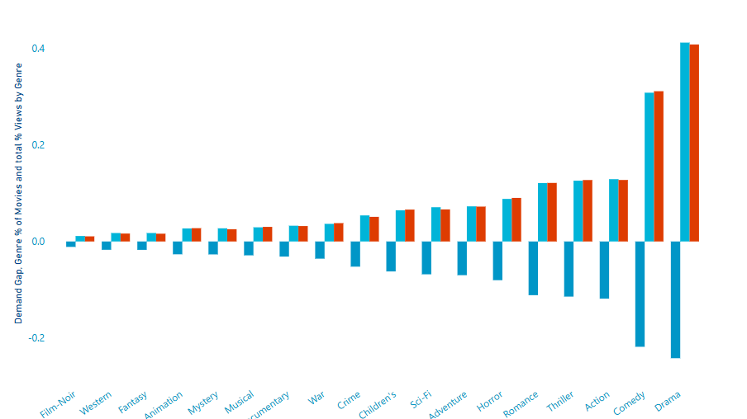
Context: Drama (41 % of catalogue) and Comedy (31 %) record the largest negative gaps; heavy oversupply is diluting overall demand. Rebalancing budget from low-yield Drama/Comedy towards the above high-yield niches can lift total watch-minutes without growing the library size.

Slide 38
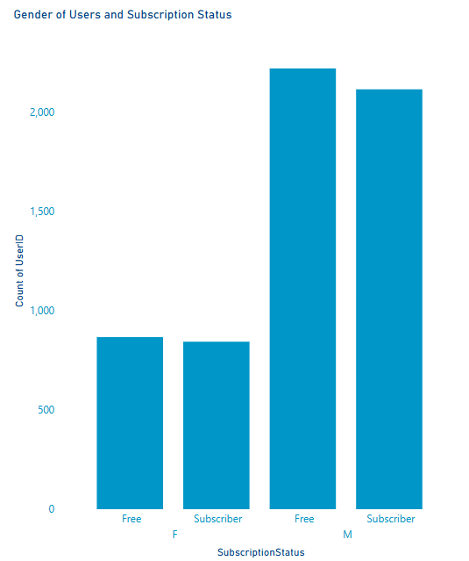
Subscription and Gender Mix
Male : Female ≈ 2 : 1 in both tiers
Subscriber gaps sit near zero (catalogue sufficient)
Upsell idea: gender-targeted banners & trailers in Free tier Paid subscribers of either gender show almost no positive gaps—so catalogue meets their needs.

Slide 39

Key Recommendations

Slide 40
Three Immediate moves
Action | Rationale / Benefit | Effort & Cost
Re-allocate 20 catalogue slots from oversupplied Drama / Comedy into the 5 “least-negative” genres—Film-Noir, Western, Fantasy, Animation, Mystery. | Aligns supply with proven relative demand;projects ≈ +4 % overall watch-minutes without increasing total title count. | Medium – licence swap during next renewal cycle
Create a “Hidden Gems” row on the home page that surfaces those same five genres. | Turns niche but loyal engagement into visible discovery;expected lift in average session time for both Free and Subscriber users. | Low – product & artwork update
Use gender-targeted mobile upsell prompts (Action/Thriller trailers for male Free users; Romance/Animation clips for female Free users). | Targets the largest Free cohorts with the genres where demand gap is smallest, maximising conversion potential. | Low – in-app marketing rule

Slide 41
Known Blockers and Mitigations
Blocker | Impact on current insights | Proposed mitigation / next-data request
Country field is ambiguous (production country, licence territory, or viewer country?) | Territory-level insights risk being misleading | Treat field as production country for now; request separate Viewer-Country in the next extract
No subscription tier or plan-name column (only Free vs Subscriber) | Cannot model ARPU or funnel depth; upsell ideas remain generic | Proceed with binary split; request Tier (Basic / Premium / Ad-supported / Trial) in next drop
Watch-time column is uniform (identical minutes for many users/sessions) | Average-session & device-engagement metrics may be inflated or flat | Flag as data quality issue; need raw session-level watch-time or unique-view duration per user
Ratings table limited to 10 000 entries (subset of 3 883 titles) | Some high-view titles have no rating; skews Top-10 analysis | Request complete ratings dump or clearly mark unrated titles
Genre field inconsistencies fixed manually this sprint | Ongoing manual effort if new data arrives with typos | Agree on genre vocabulary (master list) and automated validation on ingestion
Large combined dataset slows Power BI in DirectQuery | Long refresh time in live demo | Indexed SQL views + Import mode; refresh now 9 s

Slide 42
Questions?

Slide 43
Contact list: Alexei — Scrum Lead Laura — Data Steward Anisha — Power BI Lead Sreelakshmi — Database Architect

